Slide 1
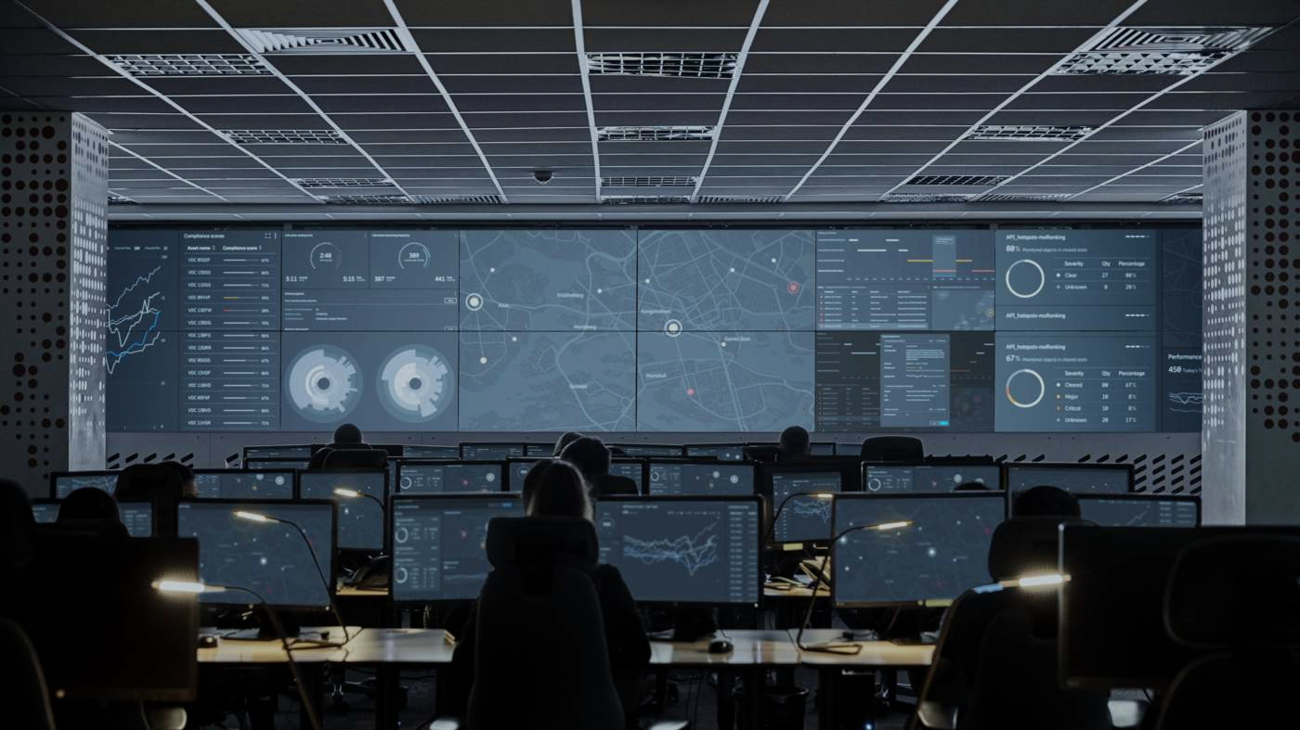

Incident Management Overview
Process Overview

Slide 2
Agenda
Incident Management Overview
Incident Management Process Flow
Incident Management Best Practices

Slide 3





Incident Management Overview
Incident Management is the process to handle an event that disrupts, or threaten to disrupt, the services provided to the end-users
Start
Root Cause analysis
Incident Logging
Incident Assignment
Incident Resolution
Incident Monitoring
Incident Reporting
Incident End
24x7 - Focused approach
Stakeholder Notification
Time Keeping
Quick and correct engagements
Technical and Management Escalations
Recovery Change Approvals during Incident
Alarm Detection
Recovery teams Engagement
Observation period post restoration
Investigation & recovery
The primary goal of the Incident Manager is to normalize service operation, minimize the adverse impact, ensure the best possible levels of service quality

Slide 4


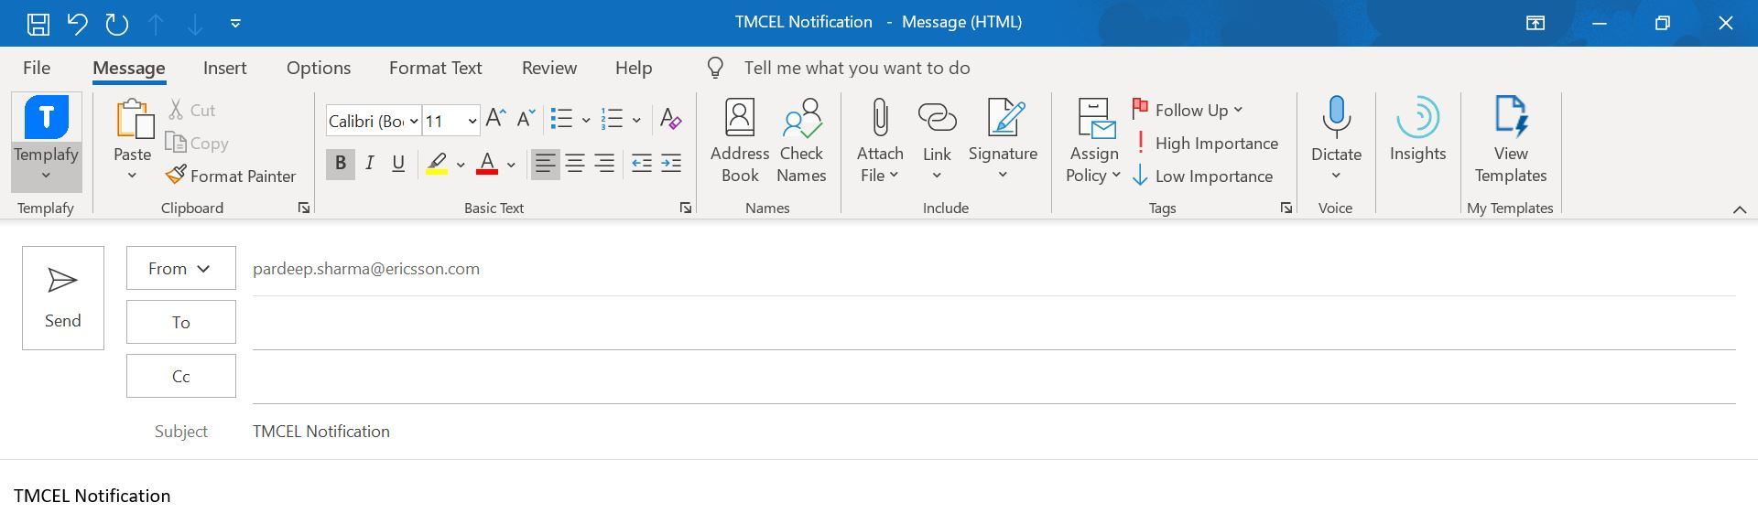
Incident Management Process Flow
Investigation / cause of issue is isolated.
Temporary workaround in place*
For permanent action, Field / 3PP assistance required (2nd LO requests MSIP)
ECR approved.
6
MSIP
3
TT raised to Back Office
2nd LO/L3 Engineer
ECAB setup for necessary approval.
4
(2nd LO requests MSIP for field support)
7
Engage Incident Manager
Incident Manager
Technical Bridge
Acknowledge alarm
Alarm diagnosis
Initial Impact assessment
Finalize incident severity
Notification
Internal Stake holders
Field / 3PP Support
1st LO Engineer
2
5
Actions to be taken for permanent fixture
TT / WO assigned to 3PP / Field Engineer.
Issue occurred
Customer Network
NOC team to check alarms status & Service testing to be performed by the customer.
Temporary workaround Implemented to recover the impact
1
8

Slide 5
IM Process Flow Continues…
Closure Notification sent
Stakeholder Notification
Incident Manager
10
IM ask NOC team to create PT for detailed RCA
9
Technical Bridge
Alarms ceased.
Services restored.
11
MSIP
1st LO Engineer
2nd LO/L3 Engineer
Problem Management (RCA of E/// issues)

Slide 6
Key Points
For all Critical & Major TTs, IM will send out the initial notification within 30 Minutes (Time to be calculated when the Incident Management gets involved). Next updates to be shared within 30 Minutes for Critical TTs and 60 Minutes for Major TTs or as decided over the bridge.
For all Sev1 (critical) Incidents, team needs to engage L3 directly. This will be followed during the stability period and will be assessed later.
During Investigation of the TT, if RC is related to existing TT, it will be marked as Duplicate and customer will be aligned to close TT.
Testing of Service will be done by MobilyPAY.
Once issue resolved, TT will be closed having customer confirmation secured. Any further query can be taken under Low TT.

Slide 7
Tickets referred as Solution Enhancement or Bug
MS to mark TT as either “SW Bug” or “solution enhancement”, and share it with ADM team for confirmation
SW bug: current implementation is not matching approved design
Solution Enhancement: current implementation/behavior as per approved design
ADM to review MS analysis and provide feedback
In case of “solution enhancement”:
ADM to confirm ADM analysis with MobilyPAY (Fahdah)
MS to close TT upon ADM confirmation
MobilyaPAY (Fahdah) align with business owner to submit BRD
In case of “SW Bug”:
MS to close TT upon ADM confirmation
ADM to track the bug fix under ADM tracker
MS to get update from ADM on progress, in order to monitor and report on SLA performance

Slide 8
Incident Notifications
 | Critical | Major
Response Time | 15 Minutes | 30 Minutes
Update Frequency | 30 Minutes | 60 Minutes
SLA (Restoration Time) | 4 Hours | 8 hours
Support | 24X7 support | 8AM-5PM/5 Business days(Local Time) support only . Any Major TT beyond this window (or Window ended) will be parked for next 8-5 Window
Notification DL
For "External" Notifications only
DL for Sev1 and Sev2 both (To be kept in To) | hisham.alotaibi@mobily.com.sa; h.alaqel@mobily.com.sa, g.alshimali@mobily.com.sa
Internal stakeholders in DL to be used for Sev 1 & Sev 2 both (in CC) | Mohit Mathur M <mohit.m.mathur@ericsson.com>; Udit Verma <udit.verma@ericsson.com>; Puneet Mittal P <puneet.p.mittal@ericsson.com>; Incident Managers_Symbian <PDLNCIDENT@pdl.internal.ericsson.com>; Imran Sidiqui Jan <imran.sidiqui.jan@ericsson.com>; Obaid Saleem <obaid.saleem@ericsson.com>; GNOC INDIA Mobily MOMO FO <gnoc.india.mobily.momo.fo@ericsson.com>; 2nd LA Mobily MOMO <PDL2NDLAMO@pdl.internal.ericsson.com>; GNOC India Incident Managers <gnoc.india.incident.managers@ericsson.com

Slide 9
Platform Operational SLA/KPI:
Severity Level | Service Hours | Response Time | Initial Issue Resolution | Final Issue Resolution - Non SW Bug related | Final Issue Resolution - SW bug Related
Critical | 24x7 | 15 Minutes | 4 hours | 3 Business days | 25 calendar days
(Severity 1)
Major | Business hours | 30 Minutes | 8 hours | 5 Business days | 25 calendar days
(Severity 2)
Minor | Business hours | 60 minutes | 48 Hours | 4 weeks | 36 Calendar days
(Severity 3)
Non Service Affecting | Business hours | 60 Minutes | 72 Hours |  | 40 calendar days
(Severity 4)

Slide 10
Best Practices
KEDB : Knowledge error data base used to re-use the knowledge and to take reference from previous learning to fix the issue asap. Quick solution reference database for similar and repetitive incident Benefit: Reduce Rework & improve Time to Implement Fix’s.
Dedicated WAR Room Setup : Benefit: Focused Attention on Incident and multi domain engagement.
Frequent Intimation and Update Notifications : Intimation via Email, Calls etc. to stakeholders for right attention.
Close coordination between IM and PM : Practice of finding Network/Service Improvement opportunities, outage reductions & standard RCA.
ECAB (Emergency Change advisory Board )& ECR (Emergency Change Request) : Standard practice for speeding up resolution via approved changes during incident.

